Slide 1
Offline-First Mobile App Design
Phil Bergner, Product Lead
Synaptic AP
Notes:
Anyone here worked on developed a mobile app using salesforce?

Slide 2

Phil Bergner
Youreka Product Lead
Developing on the Salesforce platform for 8 years with Synaptic AP
Architect for our mobile workforce AppExchange product
http://www.youreka.io
Utilizes an offline-first mobile app architecture
200k+ end users

Slide 3
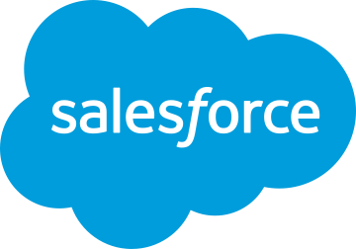
Forward-Looking Statement
Statement under the Private Securities Litigation Reform Act of 1995
This presentation may contain forward-looking statements that involve risks, uncertainties, and assumptions. If any such uncertainties materialize or if any of the assumptions proves incorrect, the results of salesforce.com, inc. could differ materially from the results expressed or implied by the forward-looking statements we make. All statements other than statements of historical fact could be deemed forward-looking, including any projections of product or service availability, subscriber growth, earnings, revenues, or other financial items and any statements regarding strategies or plans of management for future operations, statements of belief, any statements concerning new, planned, or upgraded services or technology developments and customer contracts or use of our services.
The risks and uncertainties referred to above include – but are not limited to – risks associated with developing and delivering new functionality for our service, new products and services, our new business model, our past operating losses, possible fluctuations in our operating results and rate of growth, interruptions or delays in our Web hosting, breach of our security measures, the outcome of any litigation, risks associated with completed and any possible mergers and acquisitions, the immature market in which we operate, our relatively limited operating history, our ability to expand, retain, and motivate our employees and manage our growth, new releases of our service and successful customer deployment, our limited history reselling non-salesforce.com products, and utilization and selling to larger enterprise customers. Further information on potential factors that could affect the financial results of salesforce.com, inc. is included in our annual report on Form 10-K for the most recent fiscal year and in our quarterly report on Form 10-Q for the most recent fiscal quarter. These documents and others containing important disclosures are available on the SEC Filings section of the Investor Information section of our Web site.
Any unreleased services or features referenced in this or other presentations, press releases or public statements are not currently available and may not be delivered on time or at all. Customers who purchase our services should make the purchase decisions based upon features that are currently available. Salesforce.com, inc. assumes no obligation and does not intend to update these forward-looking statements.
Notes:
Key Message Salesforce is a publicly traded company. Customers should make buying decisions only on the products commercially available.
Talk Track Before I begin, just a quick note that you should base your purchasing decisions on products and services that are currently available.

Slide 4
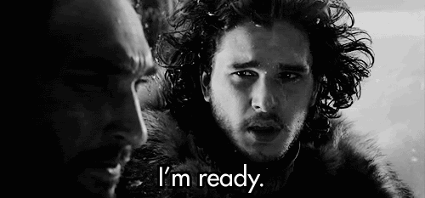
What you’ll learn today
What does Offline-First mean?
What technologies can help make offline support easier
Lessons learned developing an offline-first app
Offline data and syncing strategies Testing considerations
Notes:
Get yourself some wifi problem solved?

Slide 5
What is offline-first mobile app design?
At its core offline-first is designing your application to have base level functionality while offline with improved features while online.
Essentially, we want to let people use all core functionality while offline.
Notes:
Do they need full CRUD?

Slide 6
What are some scenarios where this might be useful?
Here are a few scenarios we’ve encountered where offline access was necessary:
Site inspections – an on-site inspector could be in a basement, elevator, or a super-secret government building.
Product compliance – a representative could be conducting a store audit and will lose/gain connection while moving through the store.
Field service technicians – a technician could be climbing behind/inside machinery and lose connectivity.
Notes:
Oil rig
Parking lot

Slide 7
Salesforce Mobile SDK - Smartstore
Salesforce helps make life easier with the mobile SDK. One of the included features is the SmartStore.
Smartstore features include:
Available for hybrid and native mobile apps
Secure, encrypted local storage
Ability to create tables and indexes
Query data using simple and smart SQL queries
Automatically wipe local data on logout
Notes:
General background for SDK - also handles authentication and token refreshes

Slide 8
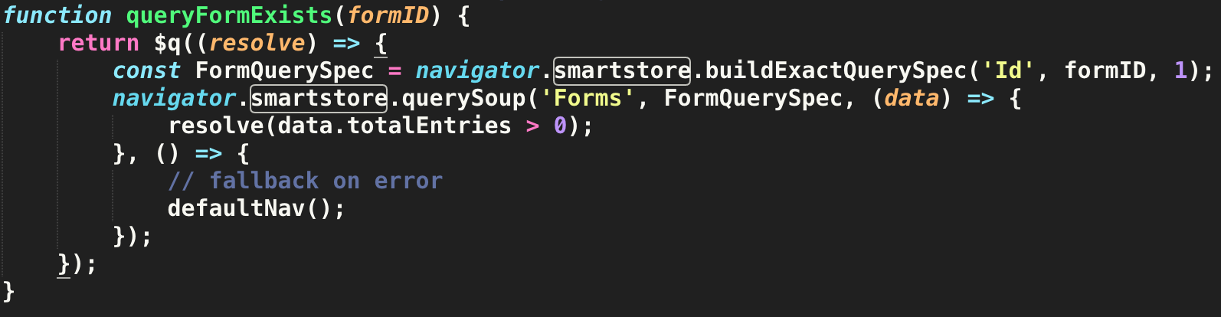
Smatstore Query Example

Slide 9
Salesforce Mobile SDK - SmartSync
Another feature of the mobile SDK is the SmartSync Framework
SmartSync features include:
Query Salesforce object metadata by calling Salesforce REST APIs.
Store the retrieved object data locally and securely for offline use.
Sync data changes when the device goes from an offline to an online state.

Slide 10
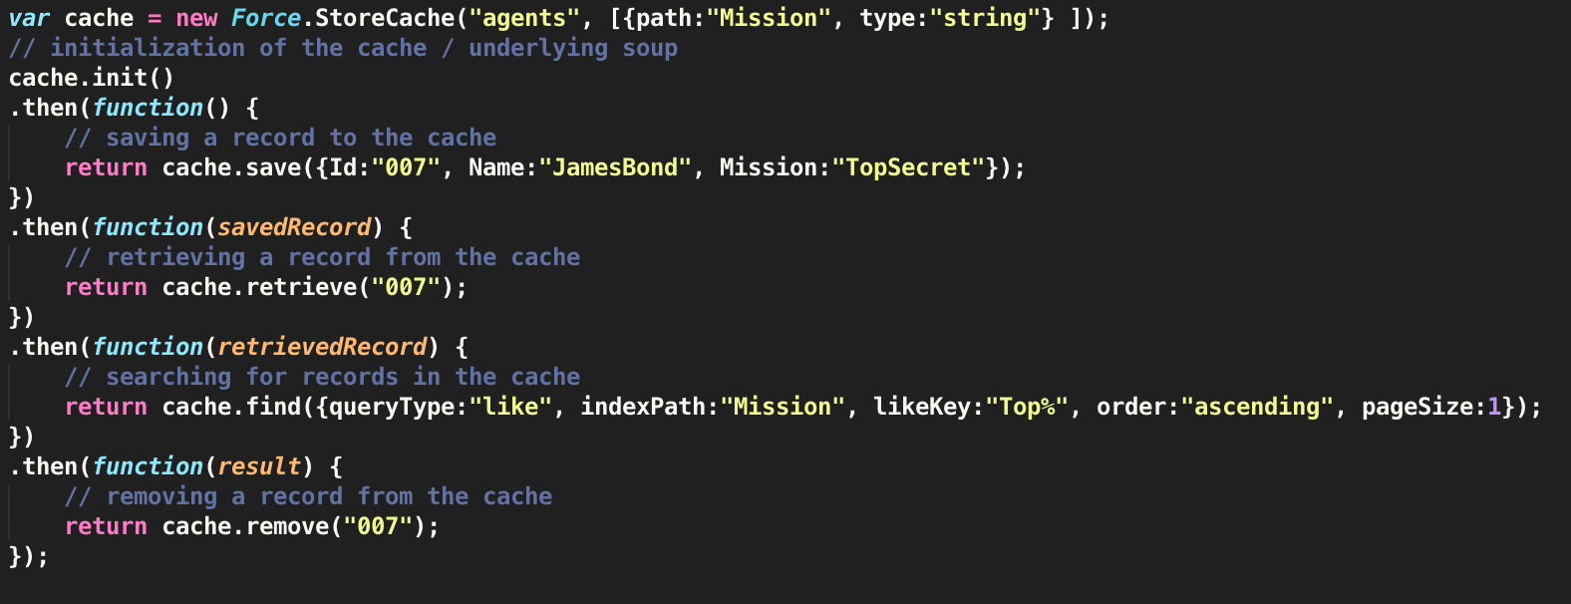
Salesforce Mobile SDK - StoreCache
Even if you don’t use SmartSync Data Framework, you can still leverage StoreCache for SmartStore operations.
StoreCache objects work internally with SmartStore soups.

Slide 11
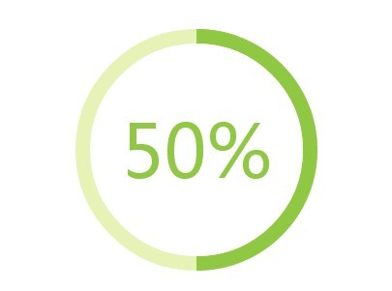
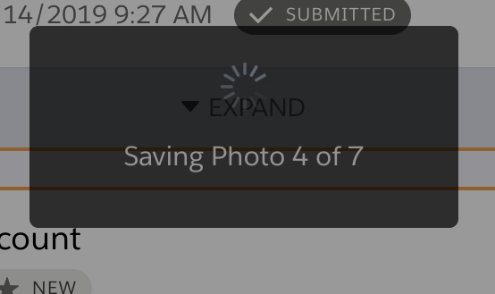
Syncing User Experience
Sync in the background if possible
Only block the user experience if its necessary
Give the user visual cues so they know what’s happening
Users want to know what’s going on
If there are multiple steps occurring, tell them! ex. ‘Getting new Accounts’, ‘Syncing Contact updates’, ‘Deleting all your hard work…poof!’
Notes:
Real life isn’t going to be like your work wifi, it may not seem necessary in testing but it may in the field.

Slide 12
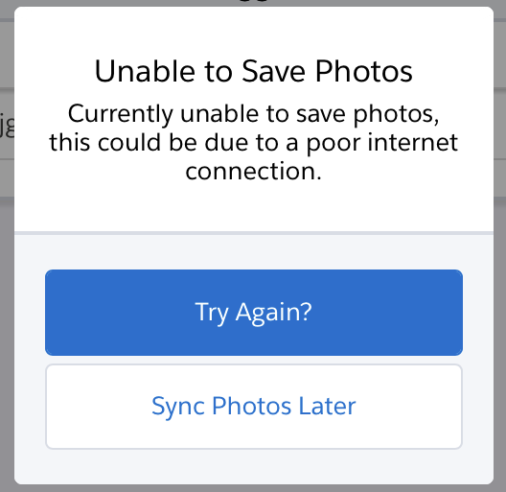
Users hate waiting
Set reasonable timeouts for UI blocking operations. If it’s taking too long, give the user the option to try it again later.
If frequent syncing is disrupting the user-experience
Revisit your criteria for blocking the UI
If users are operating in offline-mode, but remember Its important to remind them to return to online mode
Notes:
with poor connectivity its incredibly important. If something is taking too long and the user has to wait bail and try again later. Set reasonable timeouts
A good reason to block the UI is when a server-confirmation is necessary for example if someone is about to leave a site and needs to know the data has been received another would be time-sensitive data.

Slide 13

Require users to sync a minimum dataset
Briefcase model / Priming
Users begin their day by syncing with a known good connection. This should provide them with all the data they need to complete their work for the day
Users end their day by syncing with a good connection, completing their work for the day.
Ensure they have everything they might need throughout the day
Remind them to sync if they have un-synced changes

Slide 14
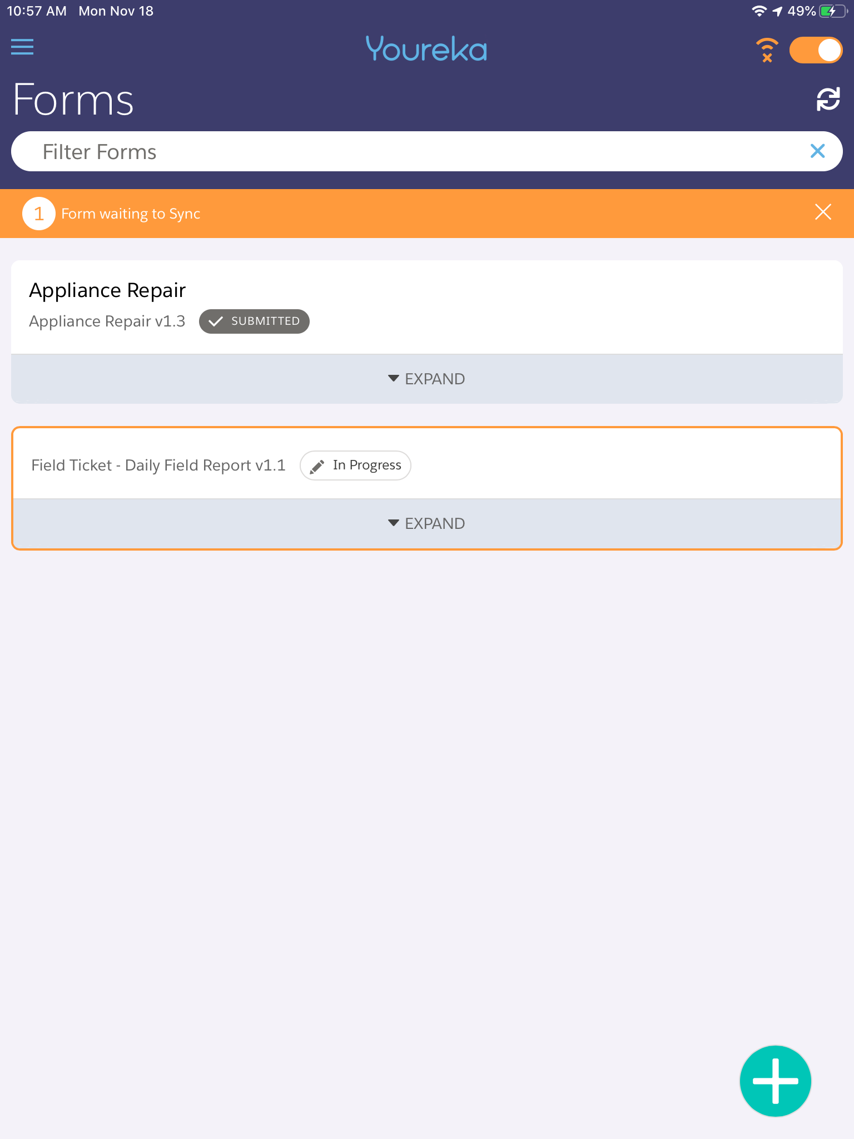
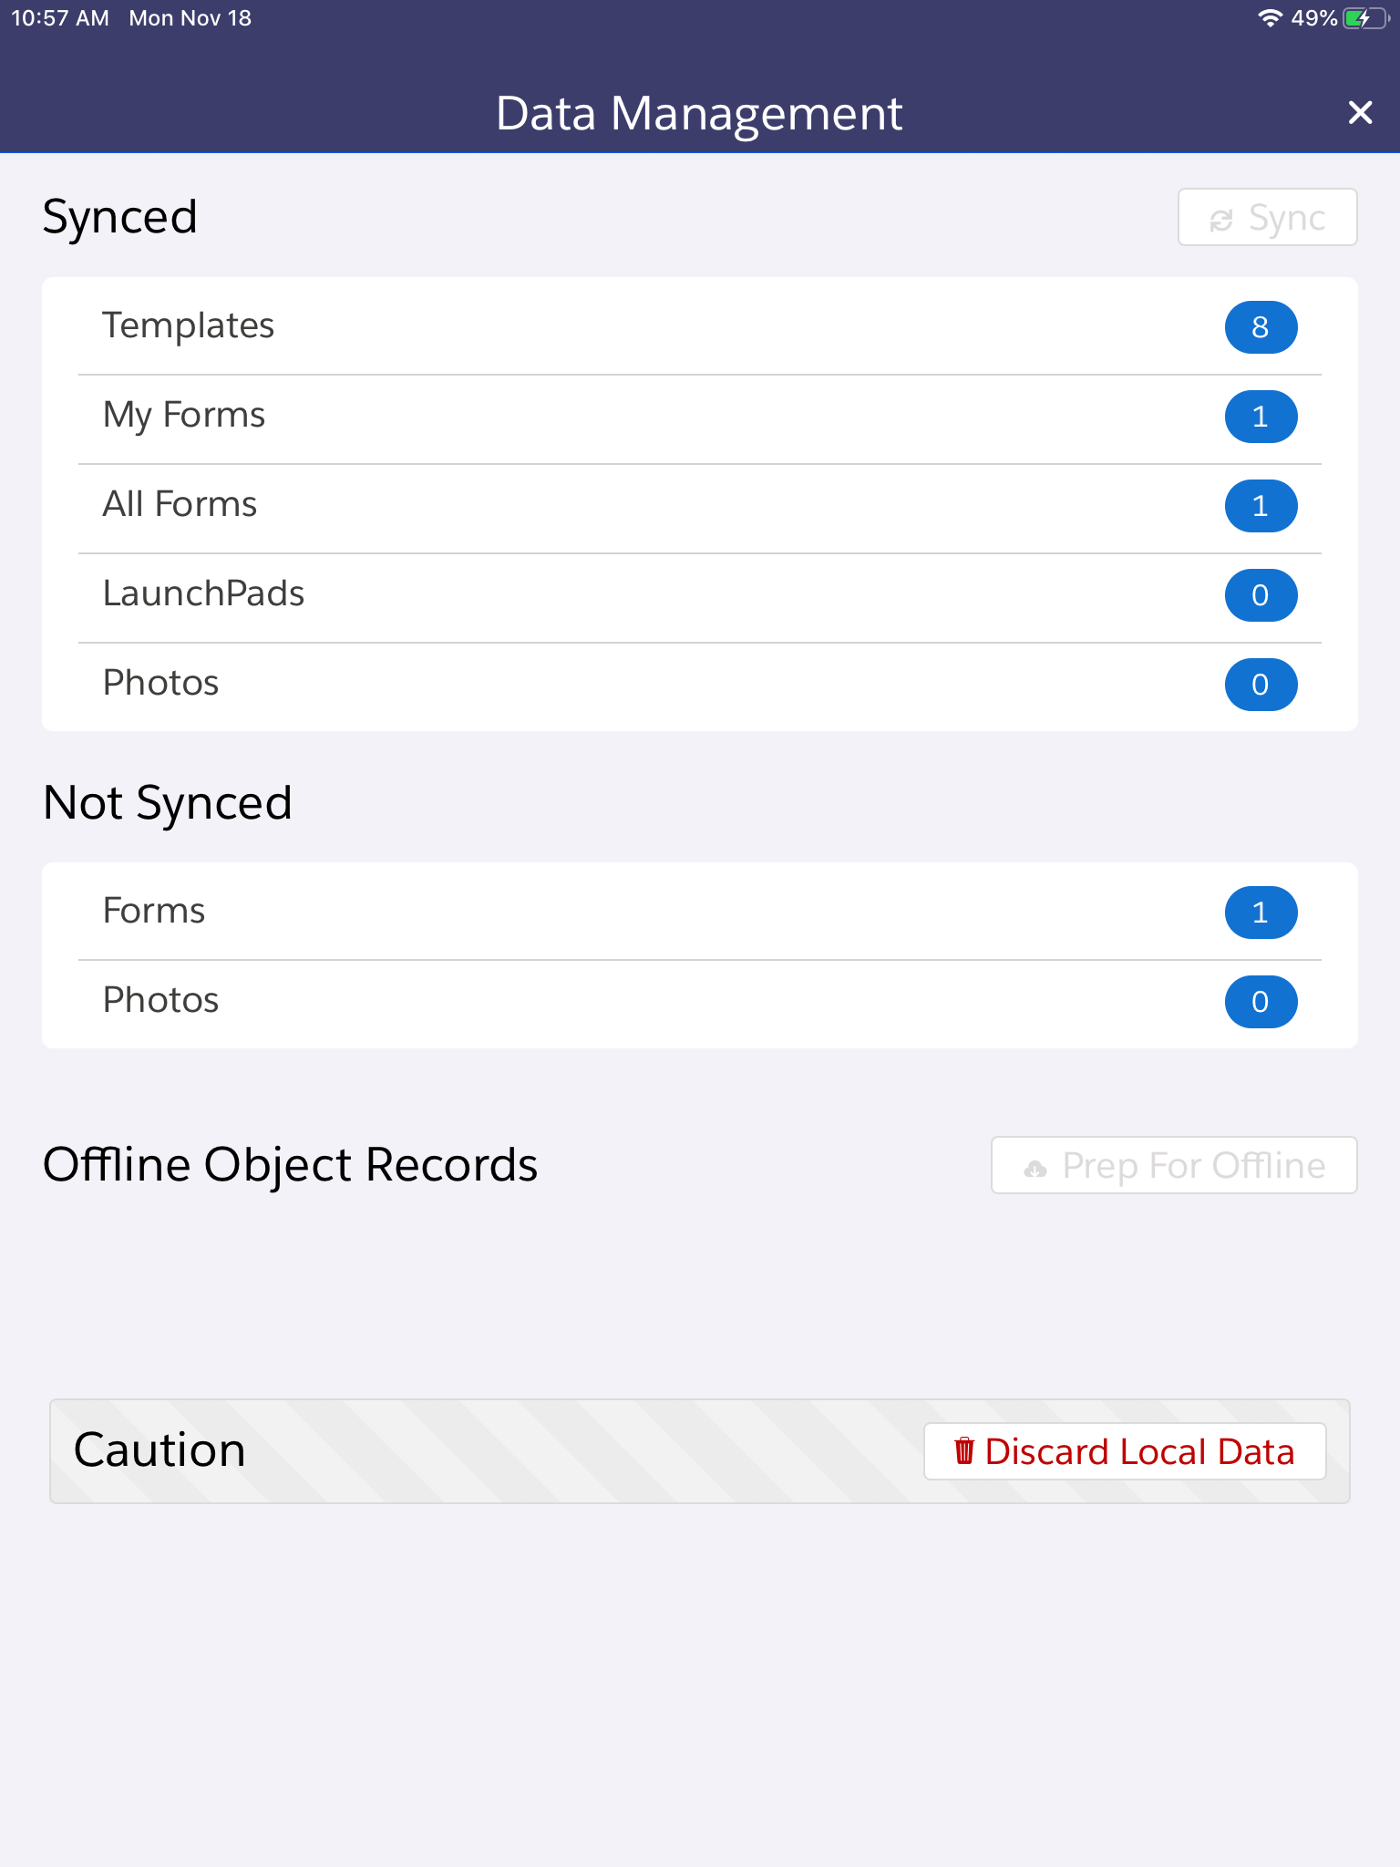
Syncing Strategies
Your strategy should be to sync early and sync often
Take advantages of background syncing if its an option
Options for this differ based on app architecture. Native applications have more access to background operations then hybrid-mobile applications running inside a webview.
Let users know they have unsynced data in the UI

Slide 15
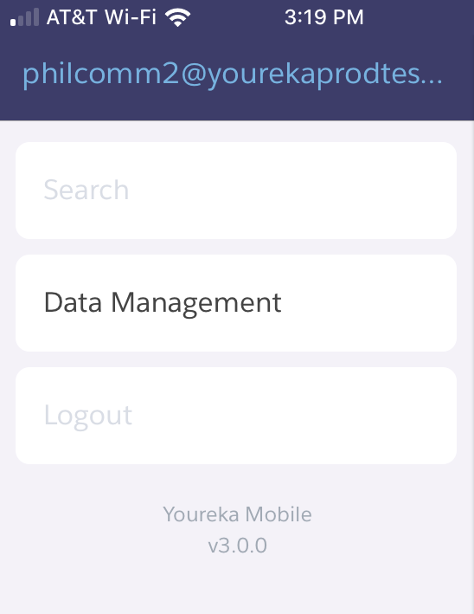
Online-only features
If certain features aren’t available offline let them know
Show online only features as disabled while offline then to completely hide it. User’s don’t like inconsistency.

Slide 16

Save locally first
Its important to immediately save the data locally so there’s no chance of it getting lost.
Smartstore
Local
Storage
Save action

Slide 17
Check online status
If there is an internet connection, query all unsynced data
Online?
Query local unsynced data
Yes
Smartstore
Local
Storage
Notes:
This launches an online status check, this same process occurs when returning online.

Slide 18
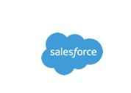
Attempt to sync to Salesforce
Attempt to connect to Salesforce to save all unsynced data.
Unsynced data
Here, take it!

Slide 19
Await confirmation of data sync
Wait for confirmation of successful data sync
Response from Salesforce
Mark data as synced
Looks, good!
Smartstore
Local
Storage

Slide 20
Poor connectivity
Design for a dropped connection
At.
Any.
Time.
Notes:
The connection can drop when first attempting to communicate with the backend. It can drop after the server has made an update and it never receives confirmation. In this scenario you have to make sure you don’t make duplicate records, consider an external ID. If the user created a new Contact and you get no confirmation from the backend it was created. You don’t want to recreate it again.

Slide 21
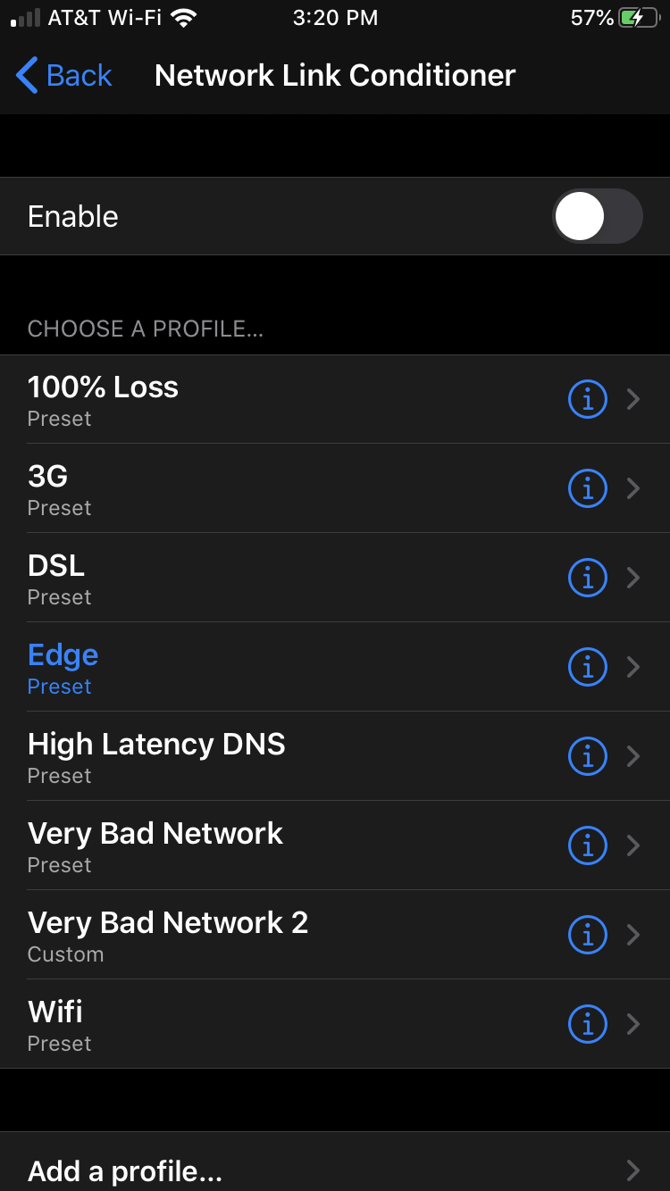
Testing
Just because it works great on your office WiFi doesn’t mean it will work great for your users
iOS Network Simulator allows you to setup and test with varying network connection types and speeds including 100% loss.
If you’re using your personal device don’t forget to disable it after testing to avoid hours of frustration over an extremely slow connection…
Notes:
This is a crucial step in mobile development testing when users might be offline. Data syncing in these scenarios can be challenging and frustrating for users. In this case it may just be best to switch to offline mode and not attempt to sync until a connection is restored, especially if its blocking user productivity.

Slide 22
Testing
This isn’t exclusive to offline-first mobile apps but test across any and all devices you can find. If you didn’t test it rest-assured a user will use it.
Also, as with any application its important to conduct load testing:
Test syncing with large amount of data
Test with many concurrent users
Test with lots of data for each API call

Slide 23

Thank you!
We’ve covered some of the basics of mobile-first offline app design and I’ve shared some of the practices that made our app successful. I hope you found it helpful!
Offline Management
https://trailhead.salesforce.com/en/content/learn/modules/mobile_sdk_offline
Mobile SDK Basics
https://trailhead.salesforce.com/en/content/learn/modules/mobile_sdk_introduction
Mobile SDK Development Tools
https://trailhead.salesforce.com/en/content/learn/projects/mobilesdk_setup_dev_tools
Phil Bergner Youreka Product Lead phil.bergner@synapticap.com @philleebe
Notes:
Feedback survey

